Slide 1
Why Apache Spark
The goal of the Spark project was to keep the benefits of MapReduce’s scalable, distributed, fault-tolerant processing framework, while making it more efficient and easier to use.
The advantages of Spark over MapReduce are:
Spark executes much faster by caching data in memory across multiple parallel operations, whereas MapReduce involves more reading and writing from disk.
Spark runs multi-threaded tasks inside of JVM processes, whereas MapReduce runs as heavier weight JVM processes. This gives Spark faster startup, better parallelism, and better CPU utilization.
Spark provides a richer functional programming model than MapReduce.
Spark is especially useful for parallel processing of distributed data with iterative algorithms.

Slide 2
Apache Spark
Apache Spark is a cluster computing platform designed to be fast.
Spark is written in Scala but designed to be highly accessible, offering simple APIs in Python, Java, Scala, R and SQL, and rich built-in libraries.
Spark Core=> Spark Core contains the basic functionality of Spark, including components for task scheduling, memory management, fault recovery, interacting with storage systems etc. Spark Core is home to the API that defines RDDs.
Spark SQL => Spark SQL is Spark’s package for working with structured data. It allows querying data via SQL as well as the Apache Hive variant of SQL, HQL.
Spark Streaming => Spark Streaming is a Spark component that enables processing of live streams of data.
Mllib => This library containing common machine learning (ML) functionality.
GraphX => GraphX is library for managing graphs (e.g. social network"s friend)
Cluster Managers => Spark can run over a variety of cluster managers, including Hadoop YARN, Apache Mesos, and cluster manager included in Spark itself called the Standalone Scheduler.

Slide 3
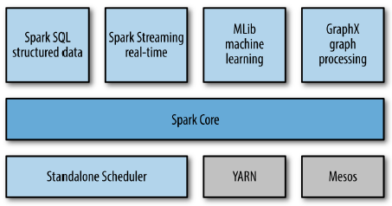
Apache Spark - Unified Stack

Slide 4
Core Spark Concept
Spark uses distributed datasets stored in HDFS or any supported storages (e.g. S3)
Every Spark application consists of a driver program that launches various parallel operations on a cluster. The driver program contains application"s main function.
Driver programs access Spark through a SparkContext object, which represents a connection to a computing cluster.
Once SparkContext initiated, it is used to build logical Directed Acyclic graph of RDDs. Then Logical DAG is converted to physical plan and stored in form of stages.
Stages are physical plan of execution and multiple logical operations are grouped together in a single physical stage and responsible to execute group of tasks.
Tasks are nothing but transformations and actions performed on RDDs and runs inside executors. Executers are distributed agents that execute the task and managed by driver. Executors runs in worker node.
Spark automatically deals with speculative execution of tasks. For example, if any node running an task on partitions either crashes or running slow , Spark will rerun it on another node.

Slide 5
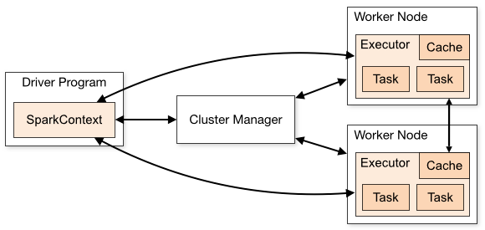
Spark Architecture

Slide 6
Resilient distributed dataset
Primary abstraction in spark:
Fault tolerant collection of elements which can be operated parallel
Immutable once constructed
Track lineage information to efficiently compute lost data
You construct RDDs:
parallelizing an existing collection in your driver program
referencing a dataset in an external storage system such as HDFS, Hbase, S3
Or from existing transformations

Slide 7




Characteristics of RDDs
Partitioned
Immutable
Resilient
RDDs, once
Can be
Split across data
created, cannot be
reconstructed even
nodes in a cluster
changed
if a node crashes

Slide 8
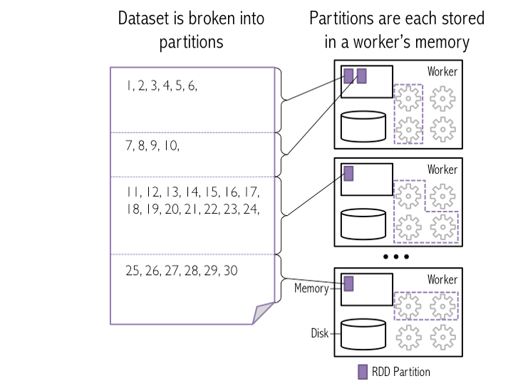
Resilient distributed dataset

Slide 9
Spark RDD Operations
RDD in Apache Spark supports two types of operations:
Transformation
Transformations are lazy
Transformations will be only executed when action runs on it.
kinds of transformations:
Narrow transformation:
An output RDD has partitions with records that originate from a single partition in the parent RDD. No shuffling of daa.
Wide transformation.
The data required to compute the records in a single partition may live in many partitions of the parent RDD. Wide transformations are also known as shuffle transformations
Actions
An Action in Spark returns final result of RDD computations. It triggers execution using lineage graph to load the data into original RDD, carry out all intermediate transformations and return final results to Driver program or write it out to file system. Lineage graph is dependency graph of all parallel RDDs of R

Slide 10

Demo
Demo
Spark operations on RDDs in the
Spark-shell interactive shell

Slide 11
RDD
An RDD simply a immutable resilient distributed collection of elements. Each RDD is split into multiple partitions, which may be computed on different nodes of the cluster.
val input = sc.textFile("/user/notroot/datasets/CricketScore.txt") // Read File
val a = sc.parallelize(List(2,1,2,4,5,3,7,6,9,8,9),4)//containing list
val b = sc.parallelize(List(("ST",20),("ST",30),("ST",50),("VK",40),("VK",20),("VK",50))) // Key Value RDDs
b.collect() //To see the rdd content
b.keys.collect() //Find all Keys
b.values.collect() //Find all values
a.getNumPartitions
sc.defaultParallelism //To check the default partition

Slide 12
Transformation
// map //flatMap //Filter // Distinct //Sampling
a.map(x => x *x).collect()
a.flatMap(x => x to 5).collect()
a.distinct.collect() //works on Key Value RDD also
a.filter(x => x%2 ==0).collect()
a.sample(false,0.2).collect()
//MapVales //flatMapValues
b.mapValues(x=> x +1).collect()
b.flatMapValues(x=> x to 35).collect()
//Union, Intersection, Subtraction, Cartesian, zip
val x = sc.parallelize(List(1,2,3))
val y = sc.parallelize(List(3,4,5))
x.union(y).collect()
x.intersection(y).collect()
x.subtract(y).collect()
x.cartesian(y).collect()
x.zip(y).collect() //zip

Slide 13
Transformation
//sortBy - Sorts this RDD by the given keyfunc
a.sortBy(( x=> x),false).collect()
b.sortBy( x=> x._1,false).collect()
b.sortBy( x=> x._2).collect()
b.sortByKey(true).collect()
//groupBy
a.groupBy( x => (x)).collect()
a.groupBy( x =>if((x % 2) == 0) {"even"}else {"odd"}).collect()
Find Good batsman if score is greater than 30
b.groupBy{x =>if(x._2 >30) {"Good"}else {"Average"}}.collect()
//Cogroup (functions that allow grouping up to 3 key-value RDDs using their keys)
val x = sc.parallelize(List((1, "apple"), (2, "banana"), (3, "orange"), (4, "kiwi")))
val y = sc.parallelize(List((5, "computer"), (1, "laptop"), (1, "desktop"), (4, "iPad")))
x.cogroup(y).collect()
//KeyBy (used to create key value RDD)
sc.parallelize(List("dog", "salmon", "salmon", "rat")).keyBy( x => x.length).collect()

Slide 14
Transformation
//reduceByKey //foldByKey //groupByKey
val a = sc.parallelize(List(("ST",20),("ST",30), ("VK",20),("ST",50),("VK",40),("VK",50), ("ST",20),("VK",50)),3)
a.reduceByKey((x,y)=>x+y).collect()
With reduceByKey, the pairs are represented as an RDD, which means the data remain distributed among the cluster. This is necessary when you are operating at scale.
With reduceByKeyLocally, all the partitions come back to the master to be merged into a single Map on that single machine. Similar to the collect action, which brings everything back to the master as an Array, if you are operating at scale, all those data will overwhelm a single machine completely and defeat the purpose of using a distributed data abstraction.
a.foldByKey(2) ((x,y)=>x+y).collect() // Initial value for each key per partition and but not driver, check a.glom().collect() to see the keys in each partition.
a.groupByKey().map(x => (x._1,x._2.sum)).collect()

Slide 15
Transformation
//aggregateByKey [Pair]
a.glom().collect()//lets have a look at what is in the partitions
a.aggregateByKey(0)((a,v)=>a+v,(p1,p2)=>p1+p2).collect()
reduceByKey and aggregateByKey are much more efficient than groupByKey.
//combineByKey() is the most general per-key aggregation functions. It has three functions.
createCombiner() to create the initial value for the accumulator on that key.
mergeValue() to merge the current value for the key and the new value in partition
mergeCombiners() function to merging the results from each partition
a.combineByKey( value=> (value, 1), ((x, value)=> (x._1 + value, x._2 + 1)), ((x, y)=> (x._1 + y._1, x._2 + y._2)))

Slide 16
Transformation
Find Average Score each player using combineByKey()
val input = sc.textFile("/user/notroot/datasets/CricketScore.txt")
val b = input.map(x=>(x.split("\t")(0),(x.split("\t")(1)).toInt))
val c = b.combineByKey((v)=>(v,1), (a: (Int,Int), v)=> (a._1 + v,a._2 + 1),(a1: (Int,Int), a2:(Int,Int))=>(a1._1+a2._1,a1._2+a2._2))
//c.map( x=> (x._1, x._2._1 / x._2._2)).collect()
c.mapValues( x=> x._1/x._2).collect()
Join/Subtract
val a = sc.parallelize(List((1,2),(3,4),(3,6)))
val b = sc.parallelize(List((3,9)))
a.join(b).collect()
a.leftOuterJoin(b).collect()
a.rightOuterJoin(b).collect()
a.fullOuterJoin(b).collect()
a.subtractByKey(b).collect()

Slide 17
Partition transformation
spark.default.parallelism defaults to the number of all cores on all machines.
The base RDD has no parent RDD to determine number of partitions, so it uses the spark.default.parallelism.
mapPartitions() (Working with per partition data)
mapPartitions() can be called for each partitions while map() and foreach() is called for each elements in an RDD, Hence one can do the initialization on per-partition basis rather than each element basis
val a= sc.parallelize(List(1,2,3,4,5,6,7,8), 2)
a.glom().collect() //see data from each partition
Write a function to see sum of list //Note sum =1(initialized)
def sumfuncpartition(numbers : Iterator[Int]) : Iterator[Int] =
{
var sum = 1
while(numbers.hasNext)
{
sum = sum + numbers.next()
}
return Iterator(sum)
}
a.mapPartitions(sumfuncpartition).collect //sum each partition data

Slide 18
mapPartitionWithIndex
mapPartitionWithIndex
It is similar to MapPartition but with one difference that it takes two parameters, the first parameter is the index and second is an iterator through all items within this partition (Int, Iterator<t>).
val a= sc.parallelize(List(1,2,3,4,5,6,7,8), 2)
a.mapPartitionsWithIndex((index:Int,x:Iterator[Int])=>{println("Partition from "+ index); if(index==1){x.map(y=>y+1)}else{(x.map(y=>y+2))}}).collect()
val b = a.mapPartitionsWithIndex((index,x)=>{println("Partition from "+ index); if(index==1){x.map(y=>y+10)}else{(x.map(y=>y+20))}}).collect()
Both the examples above are same that works with each partition value and adds 10 to partition one and 20 to partition two elements.
mapPartitionWithIndex method above returns two values (index:Int,x:Iterator[Int]), first an index of partition and second is an iterator to iterate through each element of that partition.
To see each partition data of a RDD,
a.mapPartitionsWithIndex((index:Int, it:Iterator[(Int)]) => it.toList.map(x => index + ":" + x).iterator).collect

Slide 19
Coalesce/Repartition
Coalesce transformation is used to reduce the number of partitions.
val a= sc.parallelize(List(1,2,3,4,5,6,7,8), 4)
a.glom.collect
a.coalesce(3,true).glom.collect //Data Shuffle
a.coalesce(3,false).glom.collect //Partial data shuffle
coalesce doesn't guarantee empty partitions will be removed.
Repartition=> Reshuffle the data to increase or decrease
a.repartition(5).glom.collect //May create blank partition also.
repartitionAndSortWithinPartitions
Repartition the RDD according to the given partitioner and, within each resulting partition and then sort records by their keys.
val a = sc.parallelize(List((0, 5), (3, 8), (2, 6), (0, 8), (3, 8), (1, 3)))
import org.apache.spark.HashPartitioner
a.repartitionAndSortWithinPartitions(new HashPartitioner(2)).glom().collect()
Monitor Spark Jobs
http=>//192.168.152.139=>4040/jobs/ (Localhost generally don't work, use machine ID as host.)

Slide 20
Actions
val a = sc.parallelize(List((1, "dog"), (3, "tiger"), (2, "lion"), (4, "cat"),(4, "Mouse")))
val b = sc.parallelize(List(1,4,3,6,6,4))
Collect() //Return all the elements of the dataset as an array at the driver program. This is usually useful after a filter or other operation that returns a sufficiently small subset of the data.
a.collect()
a.take(2) //Return an array with the first n elements of the dataset.
a.top(3) //Returns the top 3 by descending order
a.count() //Return the number of elements in the dataset.
a.countByKey() //Only available on RDDs of type (K, V). Returns a hashmap of (K, Int) pairs with the count of each key
a.countByValue() //Count each element by Value
b.countByValue()
b.first() //Return the first element of the dataset (similar to take(1))
b.max() //Returns the maximum
b.min() //Returns the minimum
a.saveAsTextFile(path) //Write the elements of the dataset as a text file (or set of text files) in a given directory in the local filesystem, HDFS or any other Hadoop-supported file system. Spark will call toString on each element to convert it to a line of text in the file.

Slide 21
Actions
Reduce
Aggregate the elements of the dataset using a function func (which takes two arguments and returns one). The function should be commutative and associative so that it can be computed correctly in parallel.
b.reduce((a,b) => a + b)
perform aggregations like sum/count of elements in RDD
Fold()
Similar to reduce but takes an initial value including each partition and driver.
b.fold(1)((a,b)=> a + b)
Aggregate
Used for aggregating two values,
Below example returns total of element and count of elements.
b.aggregate(1, 1)((x, y)=> (x._1 + y, x._2 + 1), ( x, y)=> (x._1 + y._1, x._2 + y._2))
Lookup
Takes the key and return the value of a key pair RDD
a.lookup(3)

Slide 22
Action
takeOrdered //Return the first n elements of the RDD using either their natural order or a custom comparator.
Reverse Order (Highest number)
val rdd = sc.parallelize(Seq(3,9,2,3,5,4),2)
rdd.takeOrdered(2)
rdd.takeOrdered(1)(Ordering[Int].reverse)
Highest based on value
val rdd = sc.parallelize(Array(("x",10),("y",14),("z",12)))
rdd.takeOrdered(1)(Ordering[Int].reverse.on(x=>x._2))
The same can be achieved using schema(case class)
case class Person(name:String,age:Int) //create a schema for RDD
val rdd2 = rdd.map(x=>Person(x._1,x._2))
rdd2.takeOrdered(1)(Ordering[Int].reverse.on(x=>x.age))
(highest/lowest repeated word in word count program)
val rdd1 = sc.parallelize(List(("Hadoop PIG Hive"), ("Hive PIG PIG Hadoop"), ("Hadoop Hadoop Hadoop")))
val rdd2 = rdd1.flatMap(x => x.split(" ")).map(x => (x,1))
val rdd3 = rdd2.reduceByKey((x,y) => (x+y))
rdd3.takeOrdered(3)(Ordering[Int].on(x=>x._2)) //Lowest value
rdd3.takeOrdered(3)(Ordering[Int].reverse.on(x=>x._2)) //Higest value

Slide 23
Accumulator/Broadcast
Shared variable, accumulators, used for aggregating values from worker nodes back to the driver program. One of the most common uses of accumulators is to count events that occur during job execution for debugging purposes.
Note that tasks on worker nodes cannot access the accumulator’s value()as accumulators are write-only variables.
val accum = sc.accumulator(0)
sc.parallelize(Array(1, 2, 3, 4,5,6),2).foreach(x => {if(x%2==0)accum += 1})
accum.value
Shared variable, broadcast variables, allows the program to efficiently send a large, read-only value to all the worker nodes for use in one or more Spark operations.
val brc = sc.broadcast(Array(100,200))
val a = sc.parallelize(List(10,20,30,40,50))
val d = a.map(x=>{if(x>=30) {x+brc.value(1)}else {x+brc.value(0)}})
d.collect
For Optimizing Broadcasts, When we are broadcasting large values, it is important to choose a data serialization format that is both fast and compact.

Slide 24
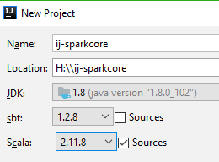
Create a Spark project in IntelliJ
Create a new project in intellij
Add the below in build.sbt
// https://mvnrepository.com/artifact/org.apache.spark/spark-core
libraryDependencies += "org.apache.spark" %% "spark-core" % "2.4.0"
dependencyOverrides += "org.scala-lang" % "scala-compiler" % scalaVersion.value
Right click on src -> main -> scala -> create new scala class -> type(Object)
Once codeing is complete -> Go to command prompt(cmd)
Project root direcotry
sbt compile
sbt clean package (This will create the jar in target directory)

Slide 25
Code
Code to find out total score of each player
import org.apache.spark.SparkContext
import org.apache.spark.SparkConf
object totalscore {
def main(args: Array[String]) {
// create Spark context with Spark configuration
val sc = new SparkContext(new SparkConf().setAppName("Find Total Score"))
//val input = sc.textFile("file:///home/notroot/SampleDataFile/CricketScore.txt")
val input = sc.textFile("/user/notroot/SampleDataFile/CricketScore.txt")
val a = input.flatMap(x => x.split(","))
val b = a.map(x => (x.split("\t")(0), x.split("\t")(1).toInt))
val res = b.reduceByKey((a, v) => a + v)
res.saveAsTextFile("/user/notroot/spark-output-totalscore")
}
}
spark-submit --master local[1] --class totalscore jar/ij-sparkcore_2.11-0.1.jar

Slide 26
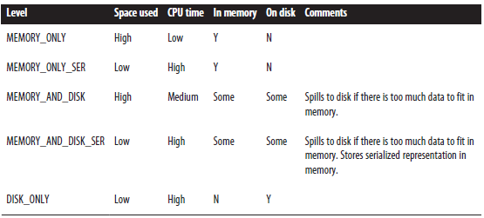
Persist(Cache) RDD
Spark"s RDDs are by default recomputed each time you run an action on them. If you would like to reuse an RDD in multiple actions, you can ask Spark to persist it using RDD.persist().
After computing it the first time, Spark will store the RDD contents in memory (partitioned across the machines in your cluster), and reuse them in future actions. Persisting RDDs on disk instead of memory is also possible.
If a node that has data persisted on it fails, Spark will re-compute the lost partitions of the data when needed. We can also replicate our data on multiple nodes if we want to be able to handle node failure without slowdown.
If you attempt to cache too much data to fit in memory, Spark will automatically evict old partitions using a Least Recently Used (LRU) cache policy. Caching unnecessary data can lead to eviction of useful data and more re-computation time.
RDDs as a method called unpersist() that lets you manually remove them from the cache.
cache() is the same as calling persist() with the default storage level.

Slide 27
DataFrame
Reading data from different file formats
val df = spark.read.format("csv").option("header","true").load("datasets/player.csv")
df.show()
val df = spark.read.json("datasets/website.json")
df = spark.read.text("/resources/textFile.txt")
df = spark.read.parquet("/resources/testJson.parquet")
df = spark.read.orc("/resources/testorc")
Simple data in DataFrame
val records = sc.parallelize(List((1,"Alice",50),(2,"bob",80))) //RDD
val df = records.toDF()
df #//Automatically provides schema, DataFrame [_1: bigint, _2: string, _3: bigint]
df.show()
val df = records.toDF("ID","Name","Marks")

Slide 28
Data Frame
Save a dataframe in csv/json format
df.coalesce(1).write.option("header","true").csv("DFOutput/csvDemo")
df.coalesce(1).write.json("DFOutput/jsonDemo")
DataFrame created using creataDataFrame method()
spark.createDataFrame(List((1,"Alice",50),(2,"bob",80))).show()
Accessing data
val df = spark.read.format("csv").option("header","true").load("datasets/player.csv")
df.first()
df.select("id","player_name").show()
df.select("id","player_name").collect() //Returns the result like dataset
df.map(r => ("Hi " + r.get(2))).collect() //Using RDD functions on Dataframe
df.select("player_name","weight").withColumn("Weight Measure", lit("POUND")).withColumnRenamed("player_name","Name").show() //lit function is for adding literal values as a column

